Slide 1

Passionately serving our partners for over 25 years.
cC

Slide 2
Client proposals:
PWA-International
Consultation for solutions and enhancements for two existing web applications and debugging a search engine.
Must demonstrate all three Web Applications, as follows:
The Duel (Part 1‐‑3)
Buggy Search Engine (3 versions)
New Battleship application developed (4 weeks or less)

Slide 3
Hosting Solutions
PWA-International
http://lkwamley.wix.com/pwa1-portfolio
http://peaceatmindalways.wix.com/pwa1-portfolio
http://dwalker15.wix.com/pwa1-portfolio
Our main development and hosting sites are wix.com and FTP server.
As a backup we will upload everything to git.hub and download work on a flash drive.
We plan to backup the clients work daily.

Slide 4
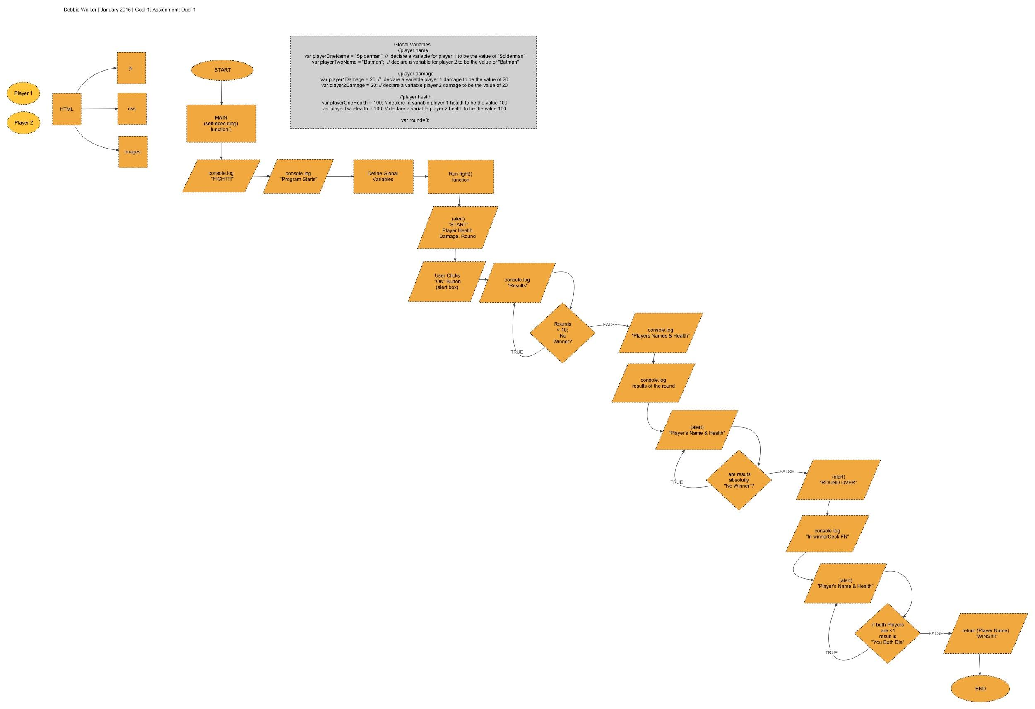
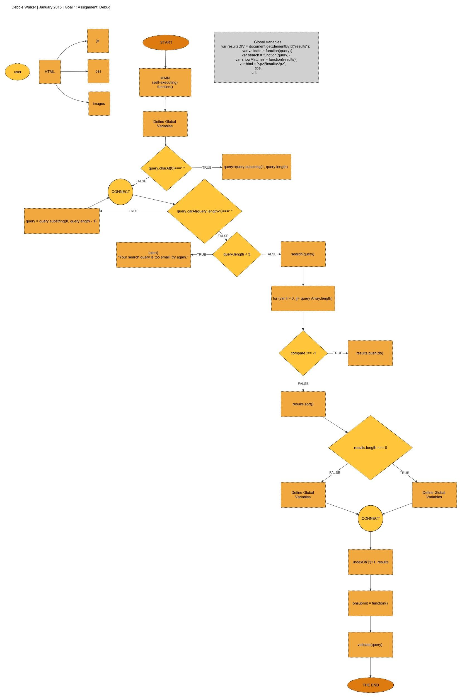

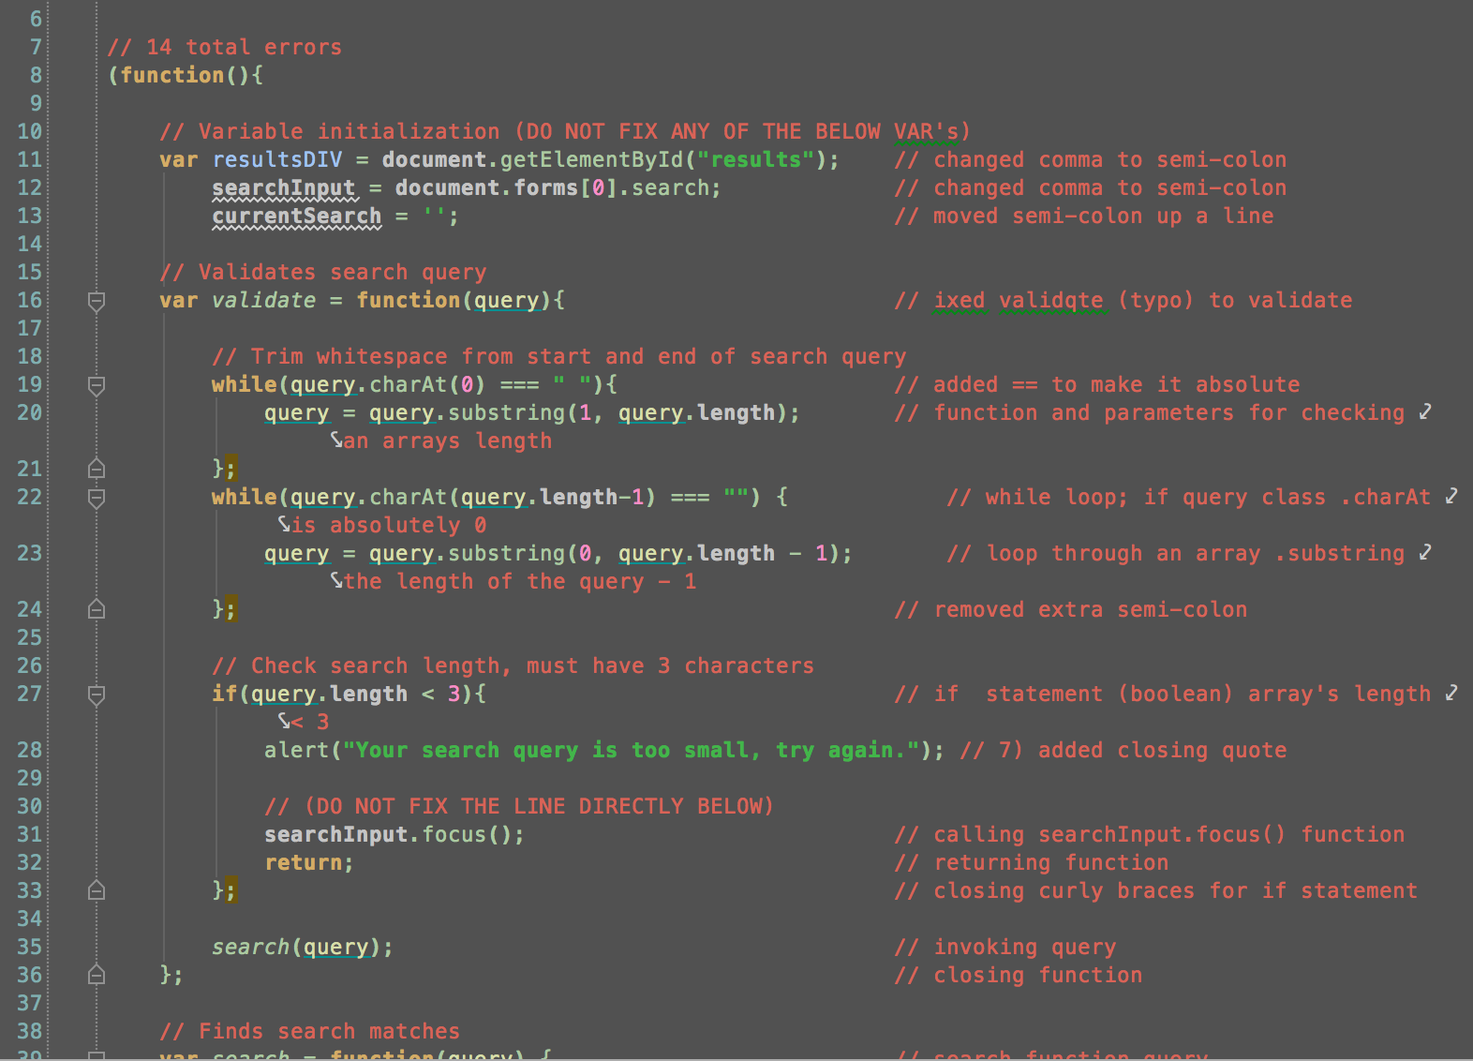
PWA-International
ADDIO®
Analyze
Design
70% of our time will
will be spent on the
first two steps
of the ADDIO process
Notes:
magnifying glass png transparent . Free cliparts that you can ...More
www.clipartbest.com

Slide 5
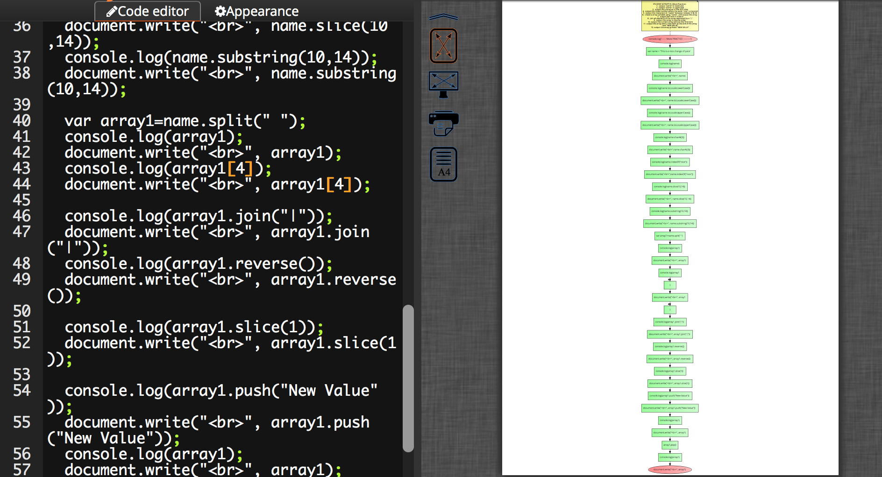
ADDIO®
Analyze
We first begin by
running your code
through a proprietary
software called
d-bugger where your
code is automatically
flow-charted
Notes:
magnifying glass png transparent . Free cliparts that you can ...More
www.clipartbest.com

Slide 6
ADDIO®
Analyze
Our staff combs
through tedious
and time-consuming
code to analyze
opportunities to fix
inefficiencies and to
optimize performance
Notes:
magnifying glass png transparent . Free cliparts that you can ...More
www.clipartbest.com

Slide 7
Notes:
magnifying glass png transparent . Free cliparts that you can ...More
www.clipartbest.com

Slide 8
Notes:
magnifying glass png transparent . Free cliparts that you can ...More
www.clipartbest.com

Slide 9
Notes:
magnifying glass png transparent . Free cliparts that you can ...More
www.clipartbest.com

Slide 10
Hosting Solutions
PWA-International
http://lkwamley.wix.com/pwa1-portfolio
http://peaceatmindalways.wix.com/pwa1-portfolio
http://dwalker15.wix.com/pwa1-portfolio
Our main development and hosting sites are wix.com and FTP server.
As a backup we will upload everything to git.hub and download work on a flash drive.
We plan to backup the clients work daily.

Slide 11
Notes:
magnifying glass png transparent . Free cliparts that you can ...More
www.clipartbest.com

Slide 12
Notes:
magnifying glass png transparent . Free cliparts that you can ...More
www.clipartbest.com

Slide 13
Q & A:
PWA-International
Your comments mean a lot to us.
If after the meeting you should have a comment, questions or concern, please feel free to use our website’s “comment box”.
Thank You!

Slide 14
Services
PWA-International
We are an integrated, full-service interactive company.
Account Service
SWOT
(Strengths, Weakness, Opportunities, Threats)
Business Plan
Budget
Asset Management
Creative Design
Concept Development
Asset Development
Art Direction
Production
Development
ADDIO®
(Analyse, Design, Develop/Debug, Integrate/Test, Optimize)
Front End Design
Debugging
Asset Production
Hosting
Maintenance
Firewall Security
Multiple Site Backups (daily)

Slide 15
meet your team
Debra Walker | Selena Vargas | Levance Wamley

Slide 16
think of us as an extended office
Full time staff of 50 full-time associates
Everlasting supply of technical experts
Contracted on a need-to-have basis
Certified
Globally networked

Slide 17
our mission
{clearfix} is a technological engine primarily made up of humans.
Fueled by passion our designers, programmers and developers
who pride themselves on clean code and flawless execution and
are supported by a world-class team of account service leaders.
Notes:
From Wikipedia, the free encyclopedia
"Statement of purpose" redirects here. For use in the university and college admissions, see admissions essay.
A mission statement is a statement of the purpose of a company, organization or person, its reason for existing.
The mission statement should guide the actions of the organization, spell out its overall goal, provide a path, and guide decision-making. It provides "the framework or context within which the company's strategies are formulated." It is like a goal for what the company wants to do for the world.^{[1]}
According to Bart Christopher,^{[2]} the commercial mission statement consists of three essential components:
Key market: Who is your target client or customer (generalize if needed)?
Contribution: What product or service do you provide to that client?
Distinction: What makes your product or service unique, so that the client would choose you?

Slide 18
Client proposals:
PWA-International
Consultation for solutions and enhancements for two existing web applications and debugging a search engine.
Must demonstrate all three Web Applications, as follows:
The Duel (Part 1‐‑3)
Buggy Search Engine (3 versions)
New Battleship application developed (4 weeks or less)

Slide 19
PWA-International
ADDIO®
Analyse
Design
70% of our time will
will be spent on the
first two steps
of the ADDIO process
Notes:
magnifying glass png transparent . Free cliparts that you can ...More
www.clipartbest.com

Slide 20
ADDIO®
Analyse
Our staff combs
through tedious
and time-consuming
code to analyze
opportunities to fix
inefficiencies and to
optimize performance
Notes:
magnifying glass png transparent . Free cliparts that you can ...More
www.clipartbest.com

Slide 21
PWA-International
ADDIO®
Design
Once the analyze phase
is complete, {clearfix}
rough drafts a couple
of options to use for a
collaboration meeting
with the full team
Notes:
magnifying glass png transparent . Free cliparts that you can ...More
www.clipartbest.com

Slide 22
Service Packages
PWA-International
Full pack: $25,500
Design pack: $15,000
Programming Pack: $12,500
Hosting pack: $65/monthly
Custom packages are negotiable.
Account Service | Creative Design | Development | Hosting
Account Service | Creative Design
Account Service | Development
Account Service | Hosting

Slide 23





Client Roster
PWA-International

Slide 24




Client Profile
PWA-International
PWA-International
Technology/gaming company
Target audience: Primary teens, Secondary tweens (primarily male) Mom’s have the final say.
Competitors:
Notes:
http://static.giantbomb.com/uploads/scale_small/1/10227/285240-ea_sports_logo.jpg

Slide 25




Opportunities? No problem, we can help!
PWA-International
Clearfix has an outstanding reputation for 100% customer satisfaction.
We never meet expectations, we EXCEED
Timing is everything: we live by deadlines
We are available 24 hours a day (minus standard holidays)
We are an extension of your office - weekly status meetings
Team building events: Every 6 months
Partnered:
Notes:
Operation Smile
https://images.search.yahoo.com/images/view;_ylt=AwrTcdC.kK1UrQUAypIPxQt.;_ylu=X3oDMTBsOXB2YTRjBHNlYwNzYwRjb2xvA2dxMQR2dGlkAw--?p=operation+smile+logo&back=https%3A%2F%2Fsearch.yahoo.com%2Fyhs%2Fsearch%3Fp%3Doperation%2Bsmile%2Blogo%26type%3Dmcy_frg02_15_2_sa%26param1%3Dyhsbeacon%26param2%3Df%253D4%2526b%253DChrome%2526cc%253DUS%2526p%253Dmcy%2526cd%253D2XzuyEtN2Y1L1Qzu0AtDyEyEtB0BtCtBtG0CyDyE0AtGyDyByE0CtG0AyCzztDtGyB0DtC0B0CtAyCtB0EtBzyyEtN1Q2Zzu0StCtCtDtDtN1L2XzutBtFtDtFtDtFzztN1L1Czu%2526cr%253D950653614%2526a%253Dmcy_frg02_15_2_sa%26hsimp%3Dyhs-fullyhosted_011%26hspart%3Diry%26ei%3DUTF-8&w=208&h=188&imgurl=www.outsourcedsolutions.biz%2Fwp-content%2Fuploads%2F2013%2F06%2FOPERATION-SMILE.jpg&size=60KB&name=OPERATION-SMILE.jpg&rcurl=http%3A%2F%2Fwww.outsourcedsolutions.biz%2Fbellevue%2Fresponsibility%2Foutsourced-solutions-reviews%2F&rurl=http%3A%2F%2Fwww.outsourcedsolutions.biz%2Fbellevue%2Fresponsibility%2Foutsourced-solutions-reviews%2F&type=&no=2&tt=108&oid=457d4781fa8fd640a44d7ff2d38deabc&tit=www.operationsmile.org&sigr=12oer7fi4&sigi=12avi111f&sign=10jvi48cc&sigt=103tlvovk&sigb=1bn0ehf6d&fr=yhs-iry-fullyhosted_011&hspart=iry&hsimp=yhs-fullyhosted_011
United Way
https://images.search.yahoo.com/images/view;_ylt=AwrB8pOoka1U9n0Ad5SJzbkF;_ylu=X3oDMTIyYWZldnFkBHNlYwNzcgRzbGsDaW1nBG9pZAMyNTViNjVhMGM2YTkyY2JkN2VmMzdkNzQ4ZGM5M2JmZARncG9zAzcEaXQDYmluZw--?.origin=&back=https%3A%2F%2Fimages.search.yahoo.com%2Fyhs%2Fsearch%3Fp%3Dunited%2Bway%2Blogo%26type%3Dmcy_frg02_15_2_sa%26fr2%3Dpiv-web%26hsimp%3Dyhs-fullyhosted_011%26hspart%3Diry%26tab%3Dorganic%26ri%3D7&w=800&h=592&imgurl=d2wkegjj8g6j4.cloudfront.net%2Fimages%2Fcampaign_assets%2Fphotos%2F000%2F004%2F757%2Fwidth_800%2Funited-way-logo-colortif.gif&rurl=http%3A%2F%2Fschwans.flipgive.com%2Fcampaigns%2F4294-scurry-county-united-way&size=77.5KB&name=%3Cb%3EUnited-way-logo%3C%2Fb%3E-colortif&p=united+way+logo&oid=255b65a0c6a92cbd7ef37d748dc93bfd&fr2=piv-web&fr=&tt=%3Cb%3EUnited-way-logo%3C%2Fb%3E-colortif&b=0&ni=21&no=7&ts=&tab=organic&sigr=123k6a67r&sigb=14ll0kgo0&sigi=13dtfd61l&sigt=10v58e0jt&sign=10v58e0jt&.crumb=7rWRt/I91Qf&fr2=piv-web&hs
Children’s Miracle Network
https://www.google.com/search?q=children%27s+miracle+network&biw=813&bih=393&source=lnms&tbm=isch&sa=X&ei=FZKtVOHWA8qnNqOVgqgE&sqi=2&ved=0CAYQ_AUoAQ#imgdii=_&imgrc=H4OAJrMsxXXo_M%253A%3B-9UjnTJ67iYFFM%3Bhttp%253A%252F%252Fopentimez.com%252Fwp-content%252Fuploads%252F2013%252F03%252Fchildrensmiraclenetwork.jpg%3Bhttp%253A%252F%252Fopentimez.com%252Fchildrens-miracle-network%252F%3B2998%3B1635
Make A Wish Foundation
https://images.search.yahoo.com/images/view;_ylt=AwrB8pKdk61UKE8AyHCJzbkF;_ylu=X3oDMTIyZDdqcmE5BHNlYwNzcgRzbGsDaW1nBG9pZANkYjczMzViZGJmZTUxZTZlN2NhY2EzNDk2NzQwYzIzMgRncG9zAzEEaXQDYmluZw--?.origin=&back=https%3A%2F%2Fimages.search.yahoo.com%2Fyhs%2Fsearch%3Fp%3Dmake%2Ba%2Bwish%2Bfoundation%26type%3Dmcy_frg02_15_2_sa%26fr2%3Dpiv-web%26hsimp%3Dyhs-fullyhosted_011%26hspart%3Diry%26tab%3Dorganic%26ri%3D1&w=1050&h=300&imgurl=www.relocatecolumbus.com%2Fvsites%2F000-briankemp%2Fimage%2Fmake-a-wish-logo.jpg&rurl=http%3A%2F%2Fwww.relocatecolumbus.com%2Fhome%2Fabout-us%2Fmake-a-wish.html&size=52.6KB&name=Brian+Kemp+Real+Estate+Group+Supports+the+%3Cb%3EMake+a+Wish+Foundation%3C%2Fb%3E&p=make-a-wish+foundation&oid=db7335bdbfe51e6e7caca3496740c232&fr2=piv-web&fr=&rw=make-a-wish+foundation&tt=Brian+Kemp+Real+Estate+Group+Supports+the+%3Cb%3EMake+a+Wish+Foundation%3C%2Fb%3E&b=0&ni=21&no=1&ts=&tab=organic&sigr=11ul79c16&sigb=14sg0utj2&sigi=128e1oai4&sigt=127506hbu&sign=127506hbu&.crumb=7rWRt/I91Qf&fr2=piv-web&hsimp=yhs-fullyhosted_011&hspart=iry&type=mcy_frg02_15_2_sa

Slide 26
Evaluations
PWA-International
We all contributed to information presented on the side.
We also talked and listed to everyone’s ideas.
Debbie made the company logo and came up with the name
Levance typed the information on the slides
Selena populated slide content
We need to keep tweaking the presentation by gaining insights and feedback from the client(s).

